Slide 1
Software Configuration Management (SCM)
Ensuring Control Over Software Changes & Versions

Slide 2
What is Software Configuration Management (SCM)?
📝 Concept:
✔ Software Configuration Management (SCM) is the process of systematically managing changes in software development. ✔ Ensures traceability, consistency, and control over software changes. ✔ Helps teams manage source code, documentation, builds, and releases.

Slide 3
What are Software Configuration Items (SCI)?
📝 Concept:
✔ Software Configuration Items (SCI) are all artifacts managed under SCM, including: 🔹 Code Files (Source Code, Libraries) 🔹 Documents (Requirements, Design, Test Plans) 🔹 Build Scripts (Automation, Deployment Files) 🔹 Test Cases (Manual & Automated Tests) 🔹 Configuration Files (Settings, Properties Files)
💡 Example: 📌 Web Application SCI:
Frontend Code: HTML, CSS, React.js
Backend Code: Node.js, Python
Database Schema: SQL Scripts
Configuration: .env files, Docker
✅ Best Practice: Use Version Control Systems (Git, SVN) to manage SCIs.

Slide 4
Overview of Configuration Management Activities
📌 SCM involves key activities to control software artifacts efficiently.
✅ Key Activities in SCM: 1️⃣ Change Management → Managing software modifications systematically. 2️⃣ Version Management → Tracking different versions of software components. 3️⃣ System Building → Compiling source code & dependencies into executable systems. 4️⃣ System Release → Packaging & delivering software to users.

Slide 5
Change Management
📝 Concept:
✔ Change Management ensures that modifications to software are well-documented, reviewed, and approved before implementation. ✔ Prevents unauthorized or accidental changes that could introduce defects.
✅ Steps in Change Management: 1️⃣ Change Request → Propose the modification (Bug Fix, Feature Update). 2️⃣ Impact Analysis → Evaluate how the change affects the system. 3️⃣ Approval Process → Team reviews and approves/rejects the change. 4️⃣ Implementation → Apply and test the change. 5️⃣ Verification → Validate if the change works as expected.
💡 Example: 📌 Banking Application Update 🔹 Change Request: Add OTP verification before processing a transaction. 🔹 Impact Analysis: Security team evaluates risks & performance impact. 🔹 Approval & Implementation: Developers code, QA tests, and deploys.
✅ Best Practice: Use JIRA, ServiceNow, or Change Advisory Board (CAB) to track & approve changes.

Slide 6
Version Management
📝 Concept:
✔ Version Management (Version Control) tracks and manages multiple versions of software components. ✔ Helps developers collaborate and maintain different versions of code efficiently.
✅ Common Version Control Models: 1️⃣ Centralized Version Control (CVCS) → Uses a single central repository (Example: SVN). 2️⃣ Distributed Version Control (DVCS) → Each developer has a full copy of the repository (Example: Git).

Slide 7
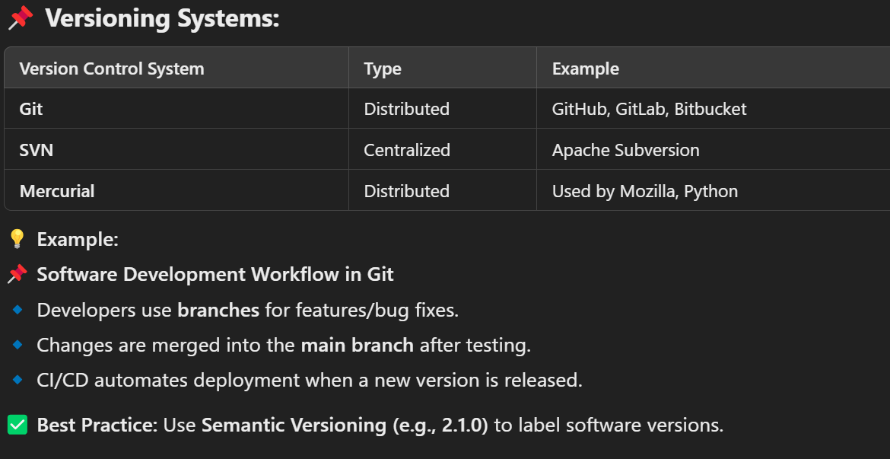
Version Management..

Slide 8
System Building
📝 Concept:
✔ System Building is the process of compiling source code, dependencies, and configurations into an executable system. ✔ Ensures software is correctly packaged for deployment.
✅ Key Components of System Building: 1️⃣ Source Code Compilation → Converting source code to machine-readable format. 2️⃣ Dependency Management → Handling external libraries (e.g., npm, Maven). 3️⃣ Build Automation → Automating repetitive build tasks. 4️⃣ Continuous Integration (CI) → Automatically testing and building code changes.
💡 Example: 📌 Mobile App Development (Android/iOS) 🔹 Developers write Java/Kotlin (Android) or Swift (iOS). 🔹 Code is built using Gradle (Android) or Xcode (iOS). 🔹 Jenkins automates CI/CD, testing and deploying new builds.
✅ Best Practice: Use CI/CD Pipelines (Jenkins, GitHub Actions, CircleCI) for faster system building.

Slide 9
System Release
📝 Concept:
✔ System Release is the process of delivering a software version to customers or production environments. ✔ Includes deployment, release notes, and rollback plans.
✅ Types of Software Releases: 1️⃣ Alpha Release → Internal testing by developers. 2️⃣ Beta Release → Released to limited users for feedback. 3️⃣ Stable Release → Fully tested & deployed to production. 4️⃣ Patch Release → Bug fixes & security updates.
💡 Example: 📌 Windows OS Updates 🔹 Microsoft releases Beta versions to testers before public rollout. 🔹 If issues arise, a rollback plan is activated.

Slide 10
Summary & Key Takeaways
✔ SCM ensures systematic control over software changes and versions. ✔ Software Configuration Items (SCIs) include source code, test cases, and documents. ✔ Key SCM activities: Change Management, Version Control, System Building, and Release. ✔ Using Git, CI/CD, and automated deployments ensures smooth software delivery.

Slide 11

Old Questions Practice
A hospital management system is to be developed, and the estimated lines of code (LOC) are calculated to be 75,000. Based on historical data for health domain projects, the average productivity is 450 LOC per person-month (PM), and the labour rate is Rs. 25,000 per month.
Calculate the estimated effort and estimated project cost for the development of the hospital management system.
Solution:
Project Cost=Effort×Labour Rate

Slide 12
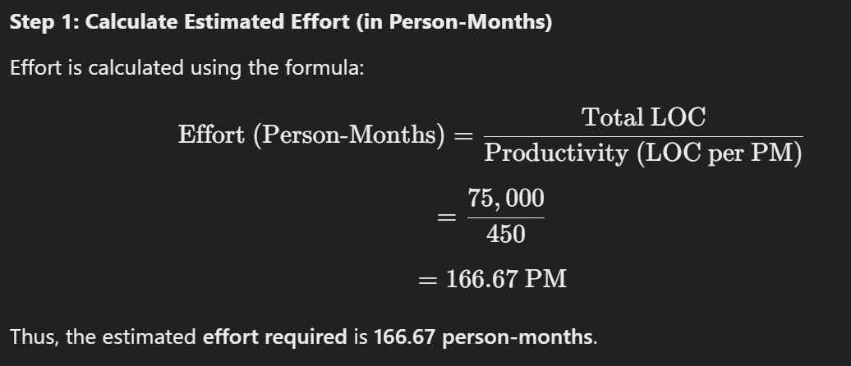
Solution:

Slide 13
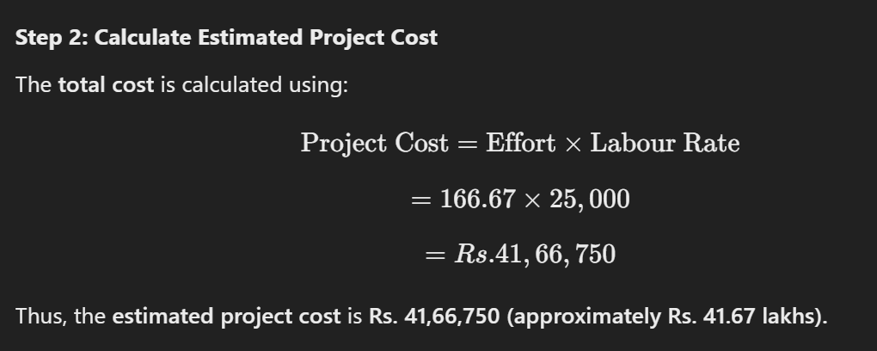
Solution..

